Slide 1
MA2012 Introduction to Mechatronics Systems Design (Circuit 1)
A/P Ang Wei Tech
Email: wtang@ntu.edu.sg
Tel: 6790 4911
Office: N3.2-01-04

Slide 2
Lab Assessments
Assessment 1
30% of Final Grade
To accomplish several mechatronics tasks in a given application in a 2 h lab session
Based on Circuit 1 – 5
Assessment 2
50% of Final Grade
4-week long project which leads to a Project Judging session in Week 14
More details later

Slide 3
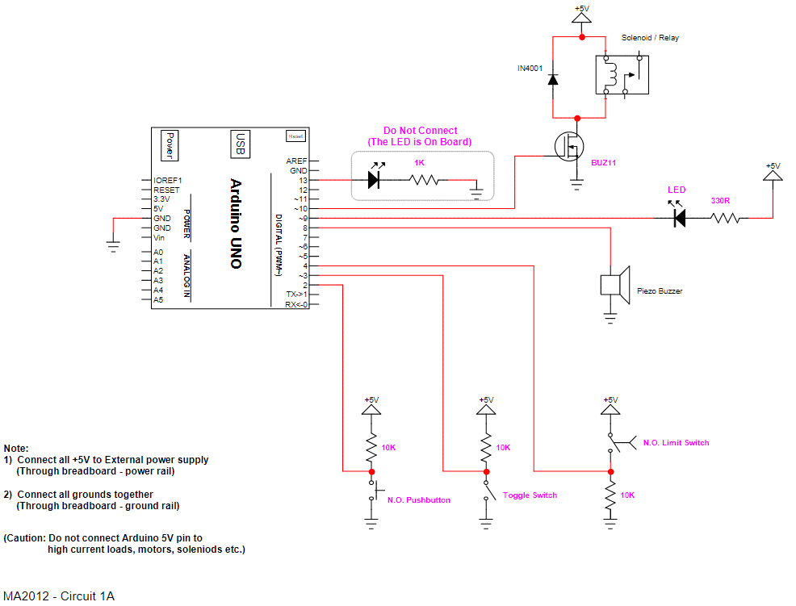
Circuit 1A

Slide 4
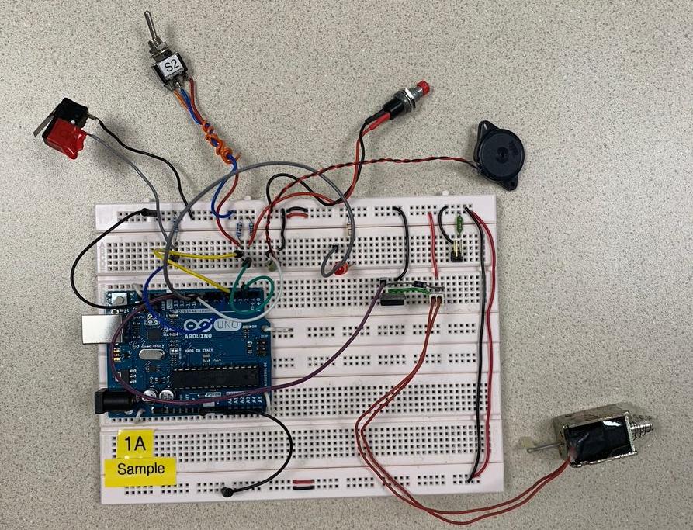
Completed Circuit 1A

Slide 5
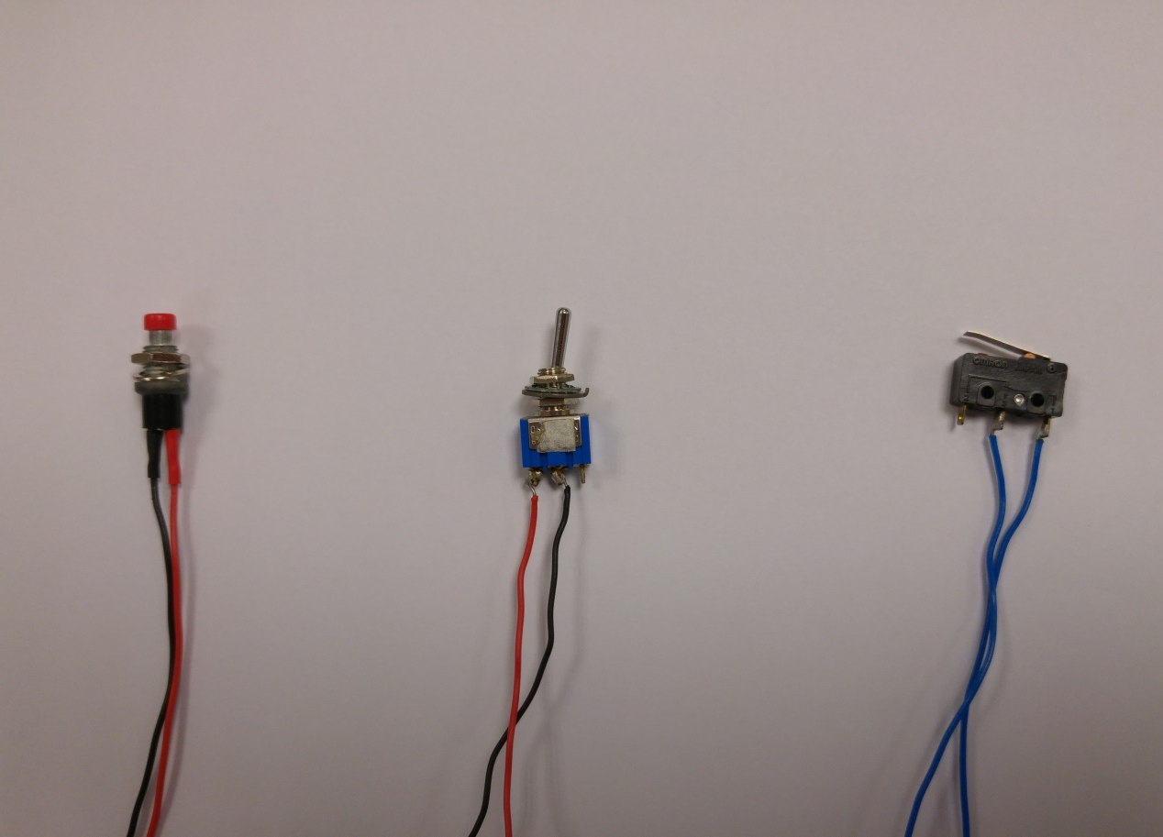
Components
Toggle Switch
Pushbutton
Limit Switch

Slide 6
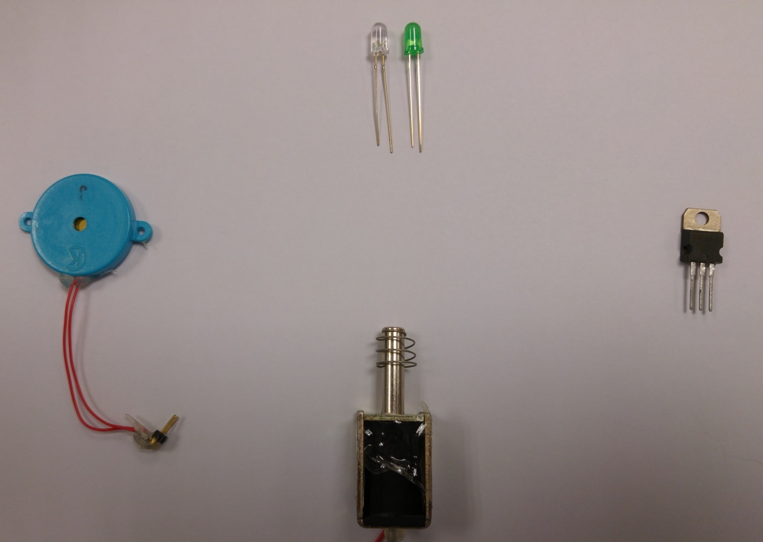
Components
Light Emitting Diode (LED)
Piezo buzzer
Transistor
BUZ11
Solenoid

Slide 7
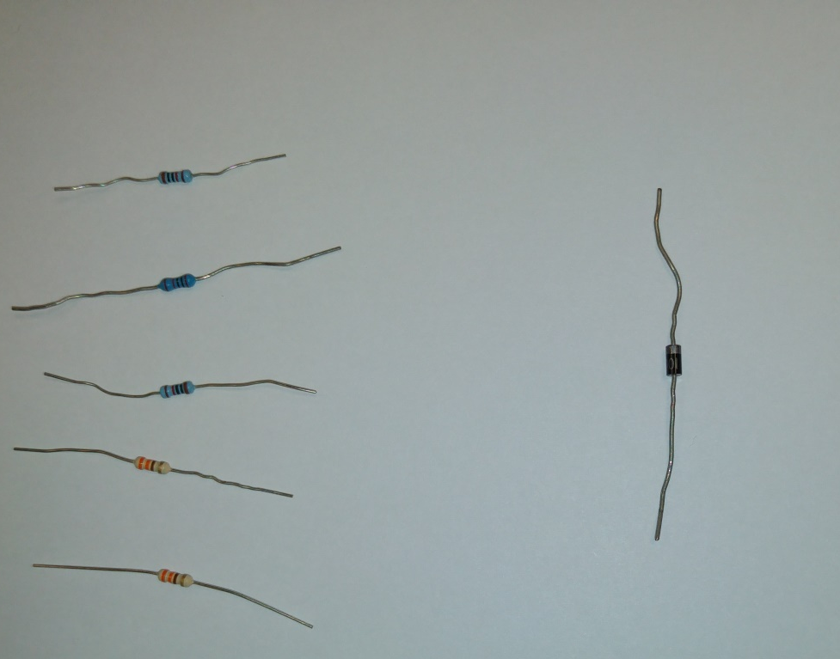
Components
Resistors
Diode IN4001

Slide 8
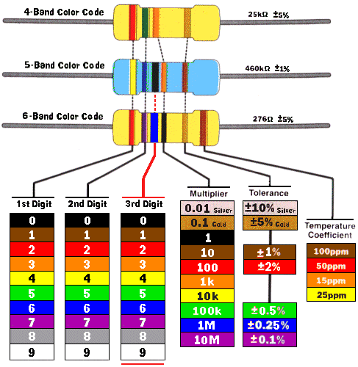
Resistor Colour Code

Slide 9
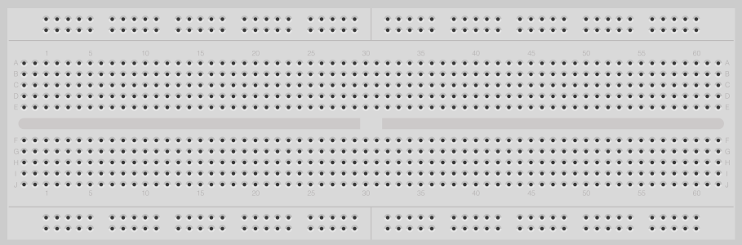
Breadboard
Connected

Slide 10
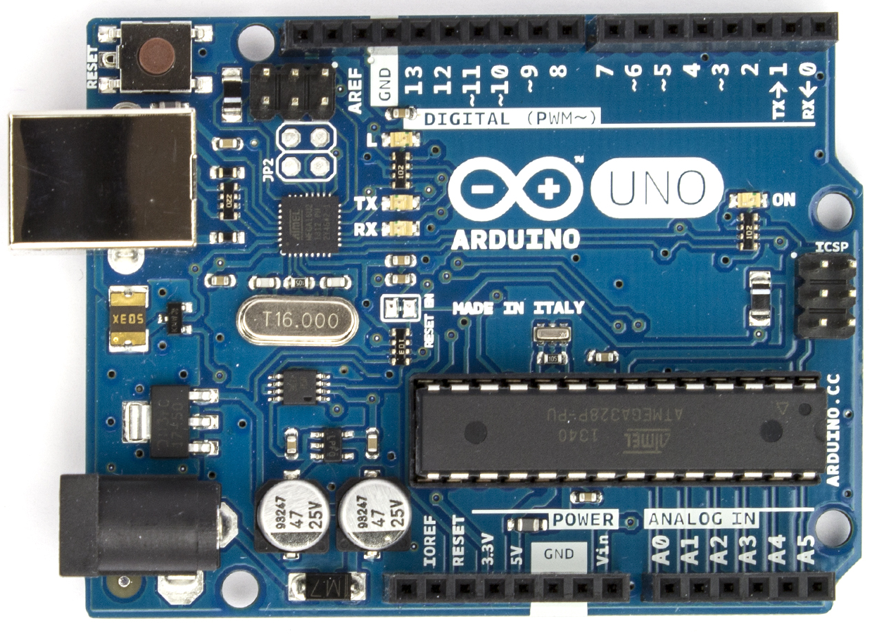
Arduino UNO MCU
Reset button
Digital I/O
USB Input
DC Input
ADC
Power & Auxiliary pins

Slide 11
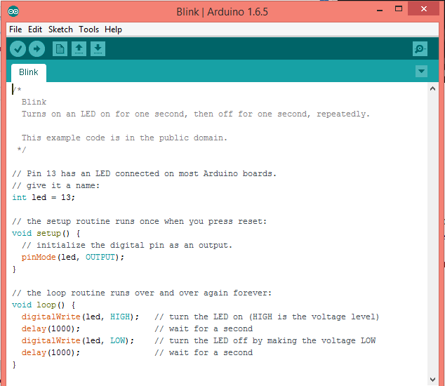
Arduino IDE (Integrated Development Environment)

Slide 12
Sample Programmes
Blink_LED.ino
To turn on and off on board LED repeatedly
Fade_LED.ino
To gradually dim and lit up LED repeatedly
Button.ino
To turn on on-board LED when Pushbutton is depressed
toneMelody_Piezo_Buzzer.ino
To sound off piezo buzzer to play a melody

Slide 13
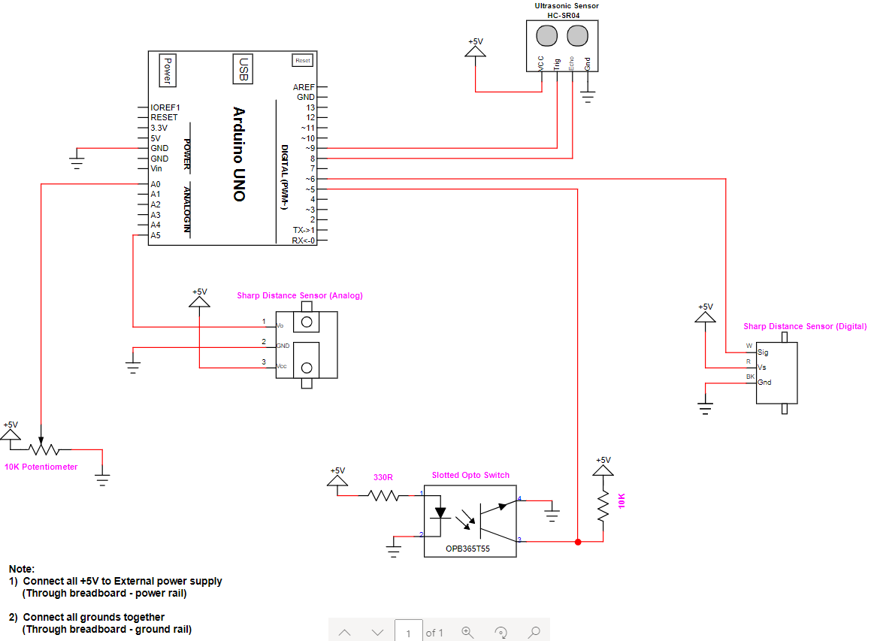
Circuit 1B

Slide 14
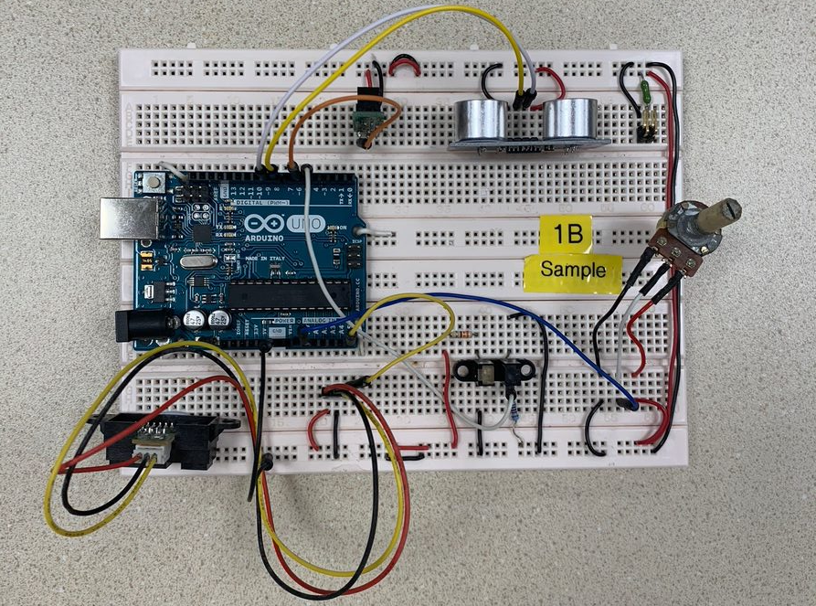
Completed Circuit 1B

Slide 15
Components
Digital sensors
Slotted Opto Switch
Distance Sensor (Digital) [Proximity Sensor]
Ultrasonic Sensor
Analog sensors
Potentiometer
Distance Sensor (Analog)

Slide 16
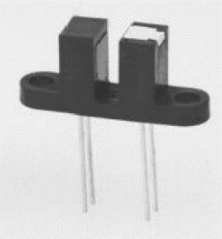
Slotted Opto Switch
See datasheet
Note the following:
Output = Active HIGH or LOW, would be dependent of the interfacing circuit with the MCU
See Digital_input.ino and make the appropriate changes to read from this sensor.

Slide 17
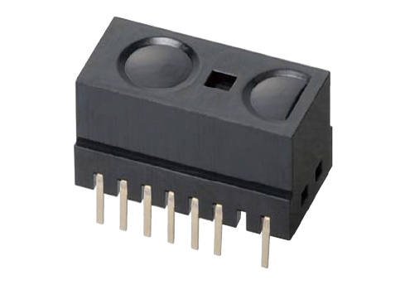
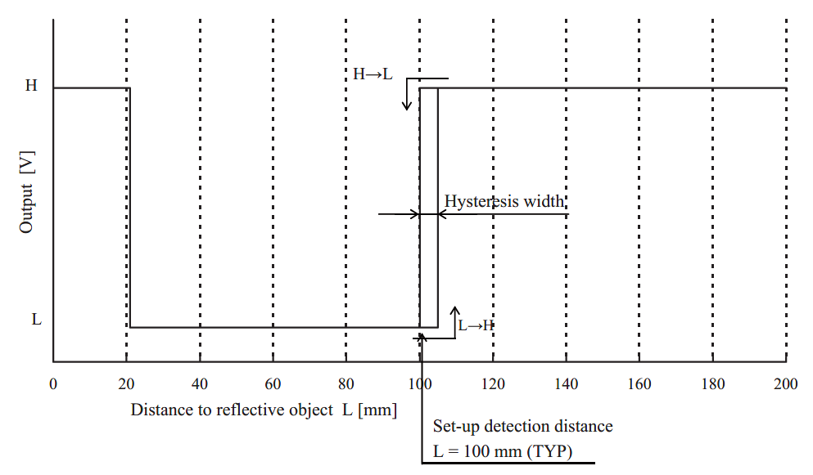
Distance Sensor (Digital) [Proximity Sensor]
See datasheet (10 cm version)
Usually used as a proximity sensor to detect presence of an object 10-20 cm away
Use Digital_input.ino

Slide 18
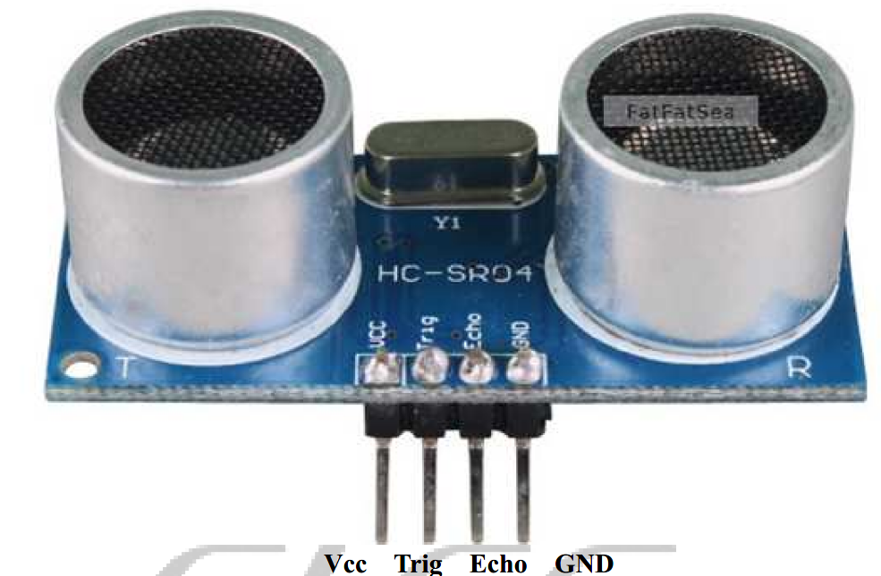
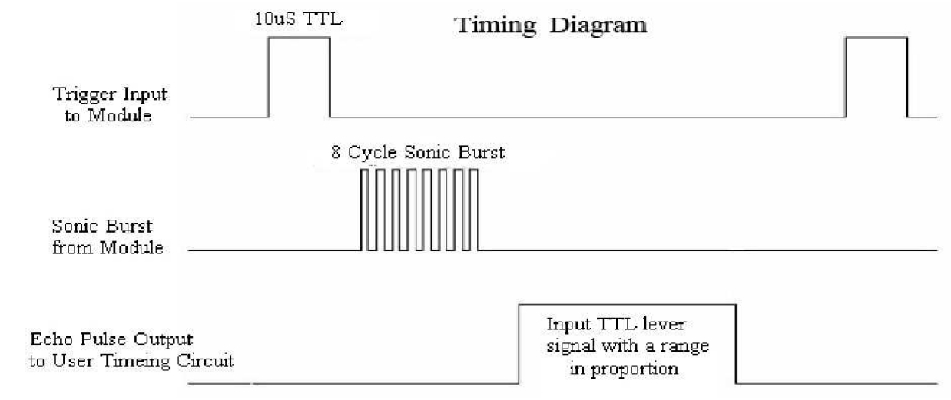
Ultrasonic Sensor
See datasheet
Distance = Time of flight x 340 m/s / 2
See Ultrasound_HC-SR04.ino

Slide 19
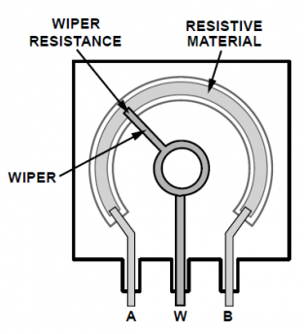
Potentiometer
See circuit labels marked on Pot
Voltage is converted to its digital equivalent form via the MCU on-board ADC (10 bit)
See analog_input.ino
Displayed units on Serial Monitor are from 0 to 1023 units. Why?
Can you calculate the scale factor (i.e. units / volt)?

Slide 20
Analog-Digital Conversion Example
Resolution = (V_{REFH} – V_{REFL})/(2^{n} – 1)
n = no. of bit, 2^{n}-1 = no. of steps
Example: V_{REFH} = 5V, V_{REFL}= 0V, input voltage = 3.0V
Resolution = 5/(2¹⁰ – 1) = 5/1023 = 4.89mV
Result of A/D conversion = 3.0V/4.89mV ≈ 614₁₀
= 10 0110 0110

Slide 21
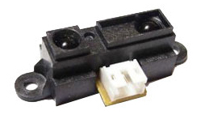
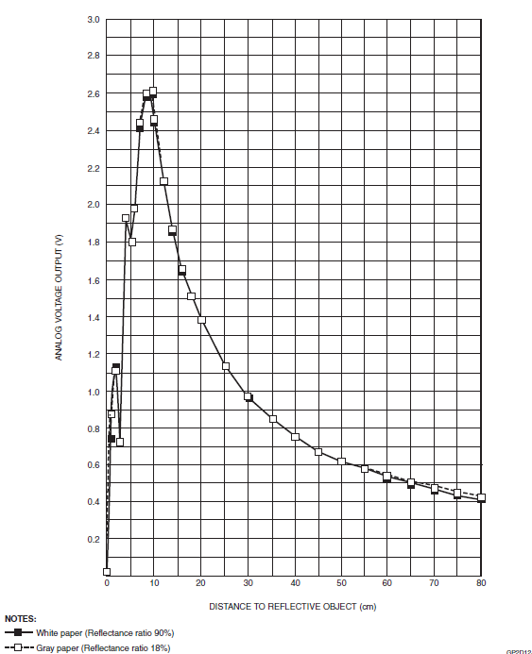
Distance Sensor (Analog)
See datasheet
Try analog_input.ino
A reminder to make appropriate changes to the pin number
See displayed units on Serial Monitor
Compare the sensor outputs at 5cm & 20 cm

Slide 22
Exercise 1-1: Cutting Machine
Write a program to perform the following tasks:
The toggle switch(red) is the ON/OFF master switch of a cutting machine.
When the master switch is ON/OFF, on-board LED (Pin 13) is ON/OFF
Nothing will happen if the master switch is OFF
The limit switch is a safety door sensor
Depressed = door closed; Opened = door opened
When the safety door is closed and the Pushbutton is depressed once, the cutter (Solenoid) will go through 10 cycles of actuation and de-actuation.
If the safety door is opened when the cutter is in action, the piezo buzzer will sound off thrice and the cutter is de-actuated immediately.

Slide 23
Exercise 1-2: Reverse Parking Sensor
Write a program to perform the following tasks:
Use the Ultrasonic sensor to sense the distance, D of a car’s rear bumper from an obstacle
The sensor is turned on when the Slotted Opto Switch is blocked.
Once the sensor is turned on,
Sound the buzzer
At 1 Hz if D > 40 cm
At 2 Hz if 20 cm < D ≤ 40 cm
Continuously if D ≤ 20 cm
Repeat Part 1 with the Analog Distance Sensor

Slide 24
Exercise 1-3: Light Dimmer
Write a program to perform the following tasks:
Use the potentiometer as a rotary light dimmer switch
Continuous Mode
Light up an array of 3 LEDs with brightness level corresponds to the output voltage of the potentiometer, i.e. 0V ≡ OFF; 2.5V ≡ 50% brightness & 5V ≡ Max brightness
Discrete Mode
Divide the output voltage of the potentiometer into 4 discrete levels
Level 1: Vout < 1.25 V → Turn off all LEDs
Level 2: 1.25 V ≤ Vout < 2.5 V → Turn on 1 LED
Level 3: 2.5 V ≤ Vout < 3.75 V → Turn on 2 LEDs
Level 4: Vout ≥ 3.75 V → Turn on 3 LEDs

